Slide 1
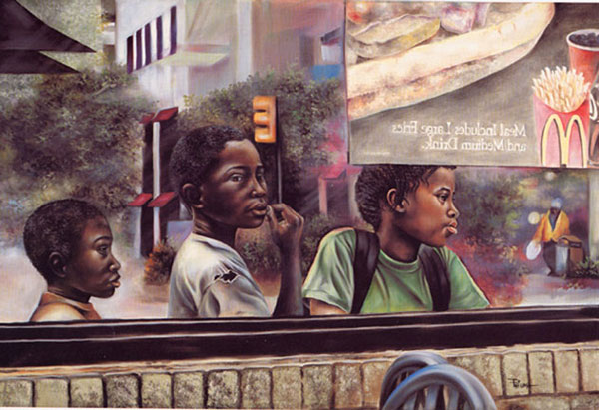
Homelessness through the Eyes of Children: A Special Needs Perspective

Slide 2
Homelessness through the Eyes of Children: A Special Needs Perspective
Julie Jochum Gartrell,
Teacher Educator, St. Paul
Angie Lauderbaugh,
Homeless Liaison Bemidji School District

Slide 3
Homelessness through the Eyes of Children: A Special Needs Perspective
This session will discuss:
Who are homeless children with special emotional needs
How are services defined for children through the
McKinney-Vento Act and IDEA
How does homelessness impact children
emotionally
How can classroom teachers and related personnel
assist children with special emotional needs
who are homeless

Slide 4
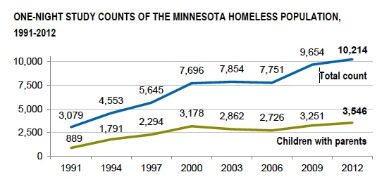
Who are the “homeless children” in MN
Wilder MN Study: October, 2012
Overall, 10,214 homeless adults, youth, and children were counted, up 6 percent over 2009
Children and youth ages 21 and younger make up nearly half (46%) of all homeless persons, similar to 2009.
Compared to their representation in the total Minnesota population, children and youth are the most likely to be homeless

Slide 5
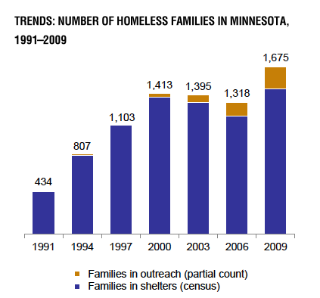
Who are the “homeless children” in MN
The number of homeless children with parents increased by 9% from 2009 to 2012.
There was a slight increase (4%) in the total number of families experiencing homelessness, but a 22% increase in the number of two-parent homeless families.
Source: Wilder 2012 Homeless Study, March 2013

Slide 6
Who are homeless children with special emotional needs
Have higher rates of low birth weight and need special care right after birth four times as often as other children.
Have twice as many ear infections, five times more diarrhea and stomach problems, and six times as many speech and stammering problems.
Are four times more likely to be asthmatic.
Source: National Center on Family Homelessness (NCFH)

Slide 7
Who are homeless children with special emotional needs
It may take four to six months for a child to recover academically from a school transfer.
Highly mobile students are half as likely to graduate from high school.
Isolation after a move impacts school attendance and performance.

Slide 8
Who are homeless children with special emotional needs
21% of homeless children repeat a grade because of frequent absence from school, compared to 5% of other children.
Have four times the average rate of delayed development.
Are suspended twice as often as other children
Source: National Center on Family Homelessness (NCFH)

Slide 9
How are services defined for children through the McKinney-Vento Act
Challenges for Children who are Homeless
Inadequate or unstable housing
Inconsistent and inadequate health care
Inadequate nutrition
Adolescent mothers
Disrupted or limited family support
Emotional stress or depression
Source: Dr. Pat Popp, Project Hope, 2012
Notes:
First of all, let me review some of the challenges that young children in homeless families face. Inadequate and/or temporary housing is devastating from the standpoints of both physical and emotional needs. And, some challenges derive from living in the poverty that most often accompanies the loss of housing, such as inadequate health care and inadequate nutrition. Many of our young children who are homeless have very young mothers who are struggling to be self-sufficient without adequate education and resources to do so. Many homeless parents and children do not have monetary or emotional support from their families. And in many cases, they are dealing with the effects of stress and depression. Finally, many homeless families with young children cannot access early childhood programs due to never being in one location long enough to move up on waiting lists.

Slide 10
Who are homeless children with special emotional needs
Every day, homeless children are confronted with stressful, often traumatic events.
74% of homeless children worry they will have no place to live.
58% worry they will have no place to sleep.
87% worry that something bad will happen to their family.
Source: National Center on Family Homelessness (NCFH)

Slide 11
Who are homeless children with special emotional needs
Half of school-age homeless children experience anxiety, depression, or withdrawal
By the time homeless children are eight years old, one in three has a major mental disorder.
Source: National Center on Family Homelessness (NCFH)

Slide 12
Who are homeless children with special emotional needs
Among young homeless children:
One out of five (between three and six years of age) have emotional problems serious enough to require professional care
16% of homeless preschoolers have behavior problems including severe aggression and hostility
Among school-age homeless children:
47% have problems such as anxiety, depression, and withdrawal, compared to 18% of other school-age children
36 % manifest delinquent or aggressive behavior, compared to 17% of other school-age
Source: National Center on Family Homelessness (NCFH)

Slide 13
Homelessness through the Eyes of Children: A Special Needs Perspective
Homelessness is usually not a solo trauma
Precedents of homelessness often include
Domestic violence
Family chaos
Economic disruptions and loss
Parental illness (physical, mental)
Isolation and lack of social supports
Patterns of high mobility
AND preoccupations that preclude reliable parental attention and awareness of children’s needs
ANNE R. GEARITY, PHD .Univ. of MN. Developmental Repair 2011

Slide 14
McKinney-Vento and IDEA Intersection
As educators we should be able to bring to bear the full range of both laws in order to optimize the access and success of all children.
Source: National Center for Homeless Education
Notes:
1. These laws do not operate exclusively of one another.
2. Nor does one law supersede the other.
~school districts and program staff often face experiences with both legal and practical responses are needed.
~OUR CHALLENGE: How can we as educators maintain balance and consistency in our efforts to address multifaceted needs while always keeping in mind the best interest of the child or youth?

Slide 15
Who are homeless children with special emotional needs
Individuals who lack a fixed, regular, and adequate nighttime residence
Sharing the housing of others due to loss of housing
Living in motels, hotels, trailer parks, or camping grounds due to lack of alternative accommodations
Living in emergency or transitional shelters
Abandoned in hospitals
Awaiting foster care placement
Living in cars, parks, public spaces, abandoned buildings, substandard housing
Migratory children who qualify as homeless
Unaccompanied youth who are living in situations described above
McKinney-Vento Act, Title X, Part C of ESEA,2001
Source: Dr. Pat Popp, Project Hope, 2012
Notes:
The definition then goes on to list a variety of living arrangements that MAY be considered homeless. Some seem pretty clear: for example, living in an emergency shelter or longer-term transitional housing, or in a car, park, or abandoned building. While we don’t see many instances where children are abandoned in hospitals, this may be an area where our Part C colleagues may be more aware of children with disabilities in hospitals whose families do not accept them. I think you can help us with identification in this area.
Other items on the list require us to go back to those 3 key words (fixed, regular, and adequate).
One example of this is sharing housing, sometimes referred to as being doubled up or tripled up. For educational purposes, a child in a family that lives with another family because they have lost their housing or similar economic hardship would be considered homeless.
In addition to looking at children awaiting foster care placement, a number of states have passed legislation that provides similar education rights to all children in foster care.
Children who qualify under Title I, Part C, for migrant education may be considered homeless, not as a result of their mobility but the adequacy of the residence.
Finally, unaccompanied homeless youth lack a fixed, regular, and adequate nighttime residence and are not in the physical custody of a parent or guardian. Since teen pregnancy is associated with developmental problems and teen homelessness, an unaccompanied homeless youth with a young child is likely to be a situation you may find in EI or ECSE
These are some highlights about the definition. We could spend our entire time together discussing its nuances, but for now, I would recommend that you work with your homeless education colleagues if unsure and consult the NCHE web site that has several briefs which unpack these terms and can assist you in making such determinations.

Slide 16
How are services defined for children through the McKinney-Vento Act
McKinney-Vento Provisions Specific to Children
Homeless children are entitled to the same free, appropriate public education as provided to other children, including special education
Local liaisons must ensure that homeless children receive educational services for which they are eligible, including special education
State Coordinators must coordinate with other agencies for services to homeless students with special needs
Source: Dr. Pat Popp, Project Hope, 2012

Slide 17
How are services defined for children through the McKinney-Vento Act
Every state has a State Coordinator for homeless education
Every school district has a Local Liaison
Identifies homeless children and youth
Assists with enrollment and services, including special education
Helps parents be meaningfully involved
Collaborates with programs within the school district
Collaborates with agencies and service providers
Source: Dr. Pat Popp, Project Hope, 2012

Slide 18
How are services defined for children through the McKinney-Vento Act and IDEA
IDEA now contains a definition of homeless children to include any children or youth considered homeless under McKinney-Vento (MV)
Source: Dr. Pat Popp, Project Hope, 2012

Slide 19
How are services defined for children through the McKinney-Vento Act and IDEA
All students with disabilities who need special education are identified, located, and evaluated; applies to students experiencing homelessness, including infants and toddlers (Child Find)
Evaluation timelines when children move (Part B)
Early intervention (EI) and early childhood special education (ECSE) services must be provided
Surrogate parents and temporary surrogates
State Advisory Panel and State Interagency Coordinating Council (SICC) representation
Source: Dr. Pat Popp, Project Hope, 2012

Slide 20
Homelessness through the Eyes of Children: A Special Needs Perspective
How can classroom teachers and
related personnel assist children
with special emotional needs
who are homeless

Slide 21
How vulnerable are you to becoming homeless?

Slide 22
Homelessness through the Eyes of Children: A Special Needs Perspective
Characteristics of Effective Teachers of Homeless and Highly Mobile Children
Well educated
High verbal ability
Expert content knowledge
Knowledge of effective teaching practices
Able to use a variety of teaching methods and materials
Cultural awareness
Ability to speak a second language
Teaching Experience
ANNE R. GEARITY, PHD .Univ. of MN. Developmental Repair 2011

Slide 23
Effective Teachers of Homeless Children
Watch for warning signs of homelessness
Make sure the student enrolls in your school’s free meal program
Do not take away possessions. Students may need their “stuff” nearby for security.
Hold the student accountable for what she or he can control (e.g., behavior or attitude) not what
is not under the student’s control
Notes:
Caring – identified as important by students over and over; associated children’s persistence in learning and their staying in school;
Being fair and respectful – being a “warm demander,” supportive and positive learning environment; high expectations; orderly classroom; a calm and quiet management style; consistent response to disruptions such as quiet reminders of appropriate behavior, a hand on a shoulder, proximity to the student, or eye contact. “Students who are highly mobile need time to adjust to the new environment in which they find themselves. Therefore, if the classroom environment is chaotic, feelings of anxiety among highly mobile students may be exacerbated.” When population is mobile, democratic practices are effected: making rules together (somehow new arrivals have to be brought up to speed) and group problem solving (emotional safety issues for new arrivals, difficulty building community if whole class is shifting).
Interacting with students – includes getting to know them and their families on a personal/individual basis; developing a personal relationship with each student; understanding of child’s background and issues facing the family; greater knowledge of a family is usually associated with increased empathy
Enthusiastic and motivating – Motivated themselves by their subject matter, their own lifelong learning, and their relationships with their students; provide a supportive environment, and exhibit supportive behaviors such as staying late, coming in early, and making a commitment to student success
Positive attitude about teaching – Glad to be at school, modeling enthusiasm for learning; high teacher self-efficacy (makes more difference for low-achieving students than high-achieving students)
Reflecting on practice – always trying to improve practice, effectiveness; children can see it.

Slide 24
How can classroom teachers and related personnel assist children with special emotional needs who are homeless
Effective Teachers of Homeless Children
Before you receive a new student:
Prepare a list of your class routines and procedures.
Prepare a new student file with information for parents and guardians.
Maintain a supply of materials for students to use at school.
Prepare a “getting-to-know-you” activity for the class to do when a new student arrives.
Have the class schedule visible.
Source: National Center for Homeless Education

Slide 25
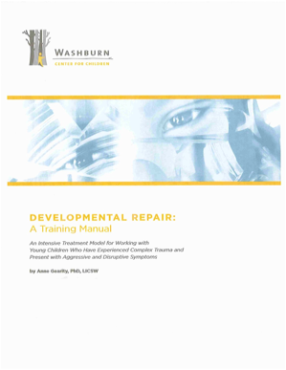
Developmental Repair Anne Gearity,UMN, 2011
Effective Teachers of Children
who are Homeless
Help children acquire a beloved object…And help them keep it.
Aren’t uncertain about curtailing aggressive play and imagination–
Know learning and school inclusion matter enormously to children who are homeless.
Start with what the child knows – and then build.
Pay attention to homework.
Children often don’t have access to resources or space to properly do homework.

Slide 26
Effective Teachers of Children who are Homeless
Watch for warning signs of homelessness
Make sure the student enrolls in your school’s free meal program
Keep a supply of healthy snacks and extra
school supplies ( even clothes or personal products)
Do not take away possessions. Students may need their “stuff” nearby for security.
Hold the student accountable for what she or he can control (e.g., behavior or attitude) not what is not under the student’s control
Discuss concerns with the Homeless Liaison Person, guidance counselor, school social worker, school nurse
Notes:
Caring – identified as important by students over and over; associated children’s persistence in learning and their staying in school;
Being fair and respectful – being a “warm demander,” supportive and positive learning environment; high expectations; orderly classroom; a calm and quiet management style; consistent response to disruptions such as quiet reminders of appropriate behavior, a hand on a shoulder, proximity to the student, or eye contact. “Students who are highly mobile need time to adjust to the new environment in which they find themselves. Therefore, if the classroom environment is chaotic, feelings of anxiety among highly mobile students may be exacerbated.” When population is mobile, democratic practices are effected: making rules together (somehow new arrivals have to be brought up to speed) and group problem solving (emotional safety issues for new arrivals, difficulty building community if whole class is shifting).
Interacting with students – includes getting to know them and their families on a personal/individual basis; developing a personal relationship with each student; understanding of child’s background and issues facing the family; greater knowledge of a family is usually associated with increased empathy
Enthusiastic and motivating – Motivated themselves by their subject matter, their own lifelong learning, and their relationships with their students; provide a supportive environment, and exhibit supportive behaviors such as staying late, coming in early, and making a commitment to student success
Positive attitude about teaching – Glad to be at school, modeling enthusiasm for learning; high teacher self-efficacy (makes more difference for low-achieving students than high-achieving students)
Reflecting on practice – always trying to improve practice, effectiveness; children can see it.

Slide 27
Effective Teachers of Homeless Children
Discuss concerns with the guidance counselor, school social worker, school nurse
Collaborate with Homeless Liaison Person
Consider Critical Privacy Issues
Notes:
Referrals and advocacy
-know your community
-identify both private and government assistance centers; develop a PERSONAL RELATIONSHIP with someone at each agency so that you can cut through red tape if necessary.
-network in the school system for quick attention to academic placement and evaluation
-attempt to work with family even before child enters the classroom
-if child may arrive without supplies, discretely prepare desk or cubby with needed materials; have outdoor clothing on hand for any child not adequately prepared for the day
-provide hygiene items and time to “clean up” if necessary
-Keep food available in the classroom; investigate “weekend food packs” provided by a local agency for families on free lunch, especially if access to food appears to be an issue for several at your school

Slide 28
How can classroom teachers and related personnel assist children with special emotional needs who are homeless
Privacy Issues with Children
who are Homeless
Disclosure (FERPA)
Who has a right to know
Have parents be informed of rights
What kind of records must the school keep
Personal attention to privacy
Source: National Center for Homeless Education

Slide 29
How can classroom teachers and related personnel assist children with special emotional needs who are homeless
Collaborating with Homeless Liaison Person.
Stable Plan
Transportation
Food-Nutrition
Education
Supportive services
Source: Liaison Toolkit

Slide 30
Strategies for Facilitation between Mental Health Resources & Homeless Liaisons
Provide enrollment personnel with a checklist of questions to ask upon enrollment,
Identify potential homelessness and eligibility for special education, along with contact information for the McKinney-Vento liaison and special education
Make sure release of information signed .
Maintain records of homeless students and provide parents with immediate access, including special education records, when they withdraw their children so services can follow the student
Source: Liaison Toolkit & Dr. Pat Popp

Slide 31
Strategies for Facilitation between Mental Health Resources & Homeless Liaisons
Learn about the services each program provides.
Develop a fact sheet about the services your program offers and the children, youth, and families who are eligible for them.
Step into each other’s worlds.
Invite early intervention and special education staff to visit shelters, low-income motels, campgrounds, or other areas where homeless families in your community live.
Explain the evaluation and assessment process and the considerations involved in drafting IFSPs and IEPs.
Source: Liaison Toolkit & Dr. Pat Popp

Slide 32
How can classroom teachers and related personnel assist children with special emotional needs who are homeless
Effective Teachers of Homeless Children
Enhance Peer Understanding
Use literature to help students develop empathy for persons who are homeless
Use Homeless Education Online Lessons
Homelessness Resource Guide K-12- http://www.wmpenn.edu/PennWeb/LTP/Reference/Teach/ResGuideK-12.html
Shedding Light on an Invisible Problem- http://www.nytimes.com/learning/teachers/lessons/20020325monday.html

Slide 33
How can classroom teachers and related personnel assist children with special emotional needs who are homeless
Effective Teachers of Homeless Children
When a student leaves:
Support the class and the student by discussing the move and having classmates write letters to the departing student.
Give the student a copy of the school’s contact information so that letters can be written back either via e-mail or traditional mail and/or
Have farewell letters inserted in the student’s records for forwarding to his or her new school
Source: National Center for Homeless Education

Slide 34
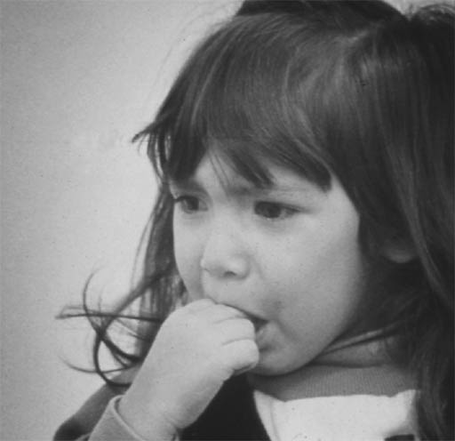
“My house is crying today because we won’t be coming home tonight”

Slide 35
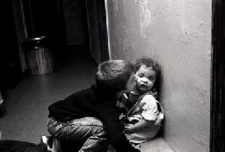
Closing Thought
The reasonable man adapts himself to the world;
the unreasonable one persists
to adapt the world to himself.

Slide 36
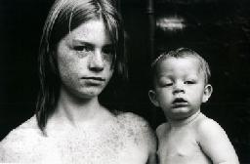
Closing Thought
Therefore all progress depends on the unreasonable man.
George Bernard Shaw (1856-1950)

Slide 37
Homelessness through the Eyes of Children: A Special Needs Perspective
Julie Jochum Gartrell,
drjuliejg@gmail.com
Angie Lauderbaugh,
alauderbaugh@bemidji.k12.mn.us
Thanks for sharing with us! ☺

